Slide 1
Eagle Emergency Readiness Club November 2022 (Based on ASM-TCCC Pressure Bandage Application)
Emergency Trauma Dressing

Slide 2
Disclaimer
“The opinions or assertions contained herein are the private views of the authors and are not to be construed as official or as reflecting the views of any professional medical provider or Embry-Riddle Aeronautical University.”
Notes:
Read the disclaimer.

Slide 3
Learning Objectives
IDENTIFY where the ETD is stored in the kit
DESCRIBE when and why you'd use the ETD
DESCRIBE how to use the ETD
(ETD = Emergency Trauma Dressing)

Slide 4
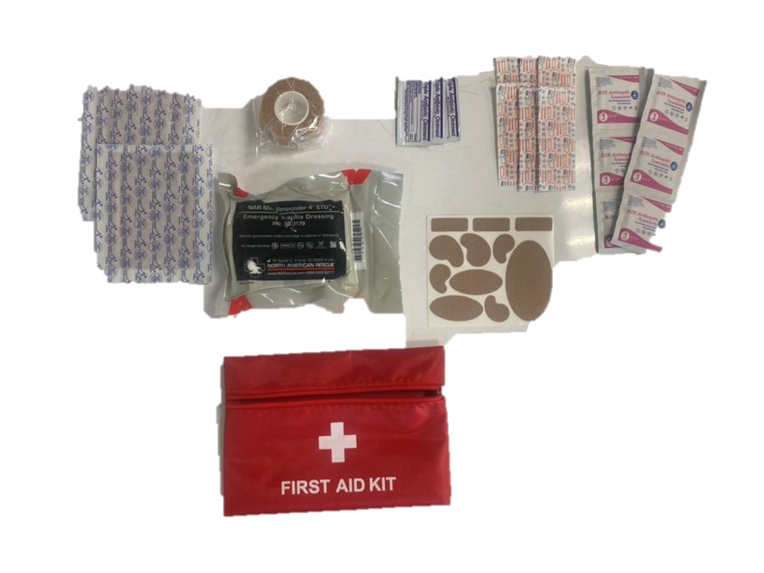
WHERE
https://soteriatraining.com/product/mini-responder-4in-emergency-trauma-dressing/

Slide 5
WHY / WHEN
“Given a trauma casualty with a bleeding wound in a location where a tourniquet cannot [or is not extreme enough to] be applied, apply an Emergency Trauma Bandage.”
- ASM-TCCC Pressure Bandage Instruction

Slide 6
HOW

Slide 7
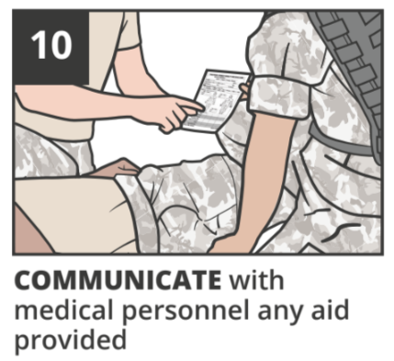
HOW

Slide 8
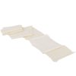
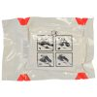
Summary of Key Points
ETD Look Like This:
Use ETD when casualty is bleeding and tourniquet cannot or does not need to be applied
Open, Place, Wrap, Reverse Wrap Tightly, Secure

Slide 9
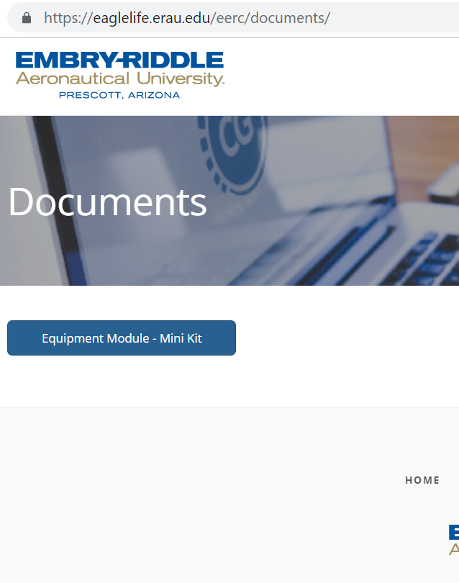
EERC Resources
Find all our Injury Training and Equipment Module Presentations on our website.
https://eaglelife.erau.edu/EERC/

