Slide 1
Eagle Emergency Readiness Club January 2023 (Based on Stanford Health Care and HealthLine)
Burns and Bleeds

Slide 2
Disclaimer
“The opinions or assertions contained herein are the private views of the authors and are not to be construed as official or as reflecting the views of any professional medical provider or Embry-Riddle Aeronautical University.”
Notes:
Read the disclaimer.

Slide 3
Learning Objectives
Burn Injuries
Degrees of Burns
Quirky Flavors of Burns
Bleeding Injuries
Types of Bleeds
Basic Care

Slide 4
Burn Injuries

Slide 5
Degrees of Burns: First Degree
Appearance
Red/pink
Dry
Painful
Treatment
Cool burned area (< 15 mins)
Apply aloe or petroleum jelly

Slide 6
Degrees of Burns: Second Degree
Appearance
Red
Painful
Dry
Blistered
Treatment
Cool burned area (< 15 mins)
Dress w/ non-stick bandage and antibiotic ointment (non-alcoholic)

Slide 7
Degrees of Burns: Third Degree
Appearance
Discolored
Dry and leathery skin
Lack of pain (nerve endings)
Treatment
Depends on burn surface area
Clean to best of your ability
See a doctor ☺

Slide 8
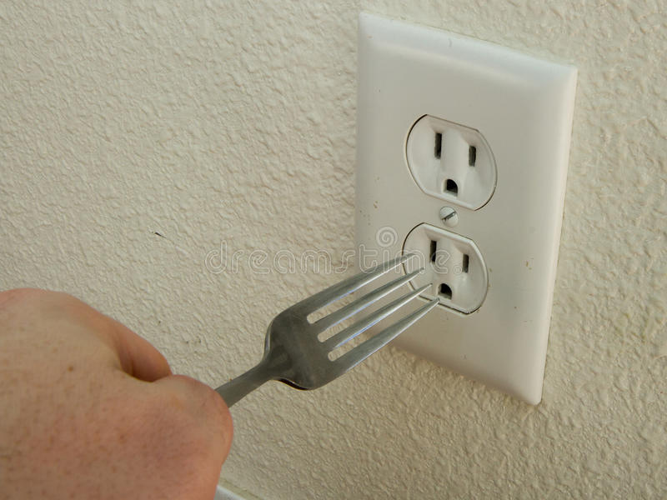
Quirky Burns: Electrical
Vary in severity but are usually worse than they appear
Be cautious but urgent
See a health care provider
Monitor victim closely

Slide 9
Quirky Burns: Chemical
Multitude of sources (ex: strong acids, drain cleaner, etc.)
Call EMS depending on severity
911
Poison Control Center: 1-800-222-1222
Procedure
Safely remove excess if possible (dry materials)
Remove contaminated clothing
Rinse wound for 20 mins w/ water
Bandage burn
Rinse and repeat if needed

Slide 10
Bleeding Injuries

Slide 11
Types of Bleeds
Capillary (Skin)
Skin layer is injured (scrapes, bruises, etc)
Most common
Easy to control
Venous (Vein)
Veins are torn or severed
Blood is bluish or dark red
Lacerations, punctures, amputations

Slide 12
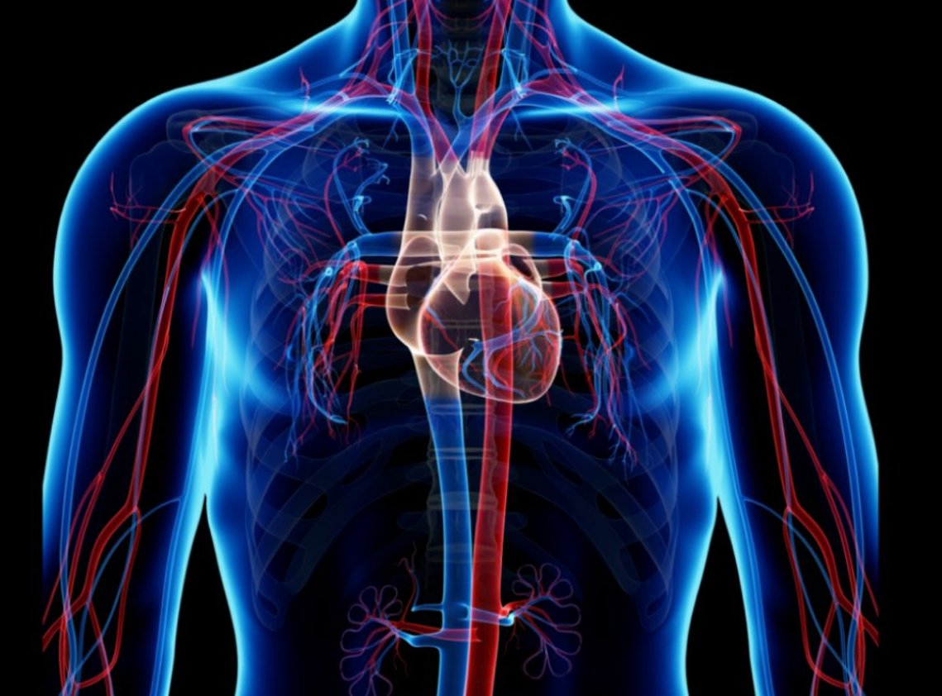
Types of Bleeds (cont.)
Arterial (Arteries/Muscles)
Most serious type of bleeding
Penetration injury, blunt trauma, internal damage
Difficult to control
Bright red
Call EMS

Slide 13
Basic Care
Low Risk (nicks, scrapes)
Disinfect
Cover
Moderate Risk (more severe scrapes, cuts)
Disinfect
Apply pressure
Cover

Slide 14
Basic Care
High Risk (lacerations, hemorrhage, heavy bleeding)
Call EMS immediately
Apply proper care depending on wound type
Slow the bleed
Monitor victim (keep them conscious)

Slide 15
Summary
Burn Injuries
Degrees of Burns
Quirky Flavors of Burns
Bleed Injuries
Types of Bleeds
Basic Care

Slide 16
EERC Resources
Find all our Injury Training and Equipment Module Presentations on our website.
https://eaglelife.erau.edu/EERC/

