Slide 1
Eagle Emergency Readiness Club November 2022 (Based on Stanford Health Care)
Burn Injuries

Slide 2
Disclaimer
“The opinions or assertions contained herein are the private views of the authors and are not to be construed as official or as reflecting the views of any professional medical provider or Embry-Riddle Aeronautical University.”
Notes:
Read the disclaimer.

Slide 3
Learning Objectives
Degrees of Burns
Quirky Flavors of Burns

Slide 4
Degrees of Burns: First Degree
Appearance
Red/pink
Dry
Painful
Treatment
Cool burned area (< 15 mins)
Apply aloe or petroleum jelly

Slide 5
Degrees of Burns: Second Degree
Appearance
Red
Painful
Dry
Blistered
Treatment
Cool burned area (< 15 mins)
Dress w/ non-stick bandage and antibiotic ointment (non-alcoholic)

Slide 6
Degrees of Burns: Third Degree
Appearance
Discolored
Dry and leathery skin
Lack of pain (nerve endings)
Treatment
Depends on burn surface area
Clean to best of your ability
See a doctor ☺

Slide 7
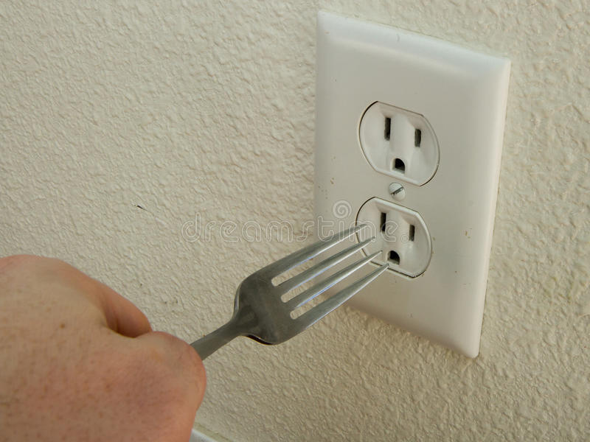
Quirky Burns: Electrical
Vary in severity but may be worse than they appear
Be cautious but urgent
See a health care provider
Monitor victim closely

Slide 8
Quirky Burns: Chemical
Multitude of sources (ex: strong acids, drain cleaner, etc.)
Call EMS depending on severity
911
Poison Control Center: 1-800-222-1222
Procedure
Safely remove excess if possible (dry materials)
Remove contaminated clothing
Rinse wound for 20 mins w/ water
Bandage burn
Rinse and repeat if needed

Slide 9
Summary
Degrees of Burns
Quirky Flavors of Burns

Slide 10
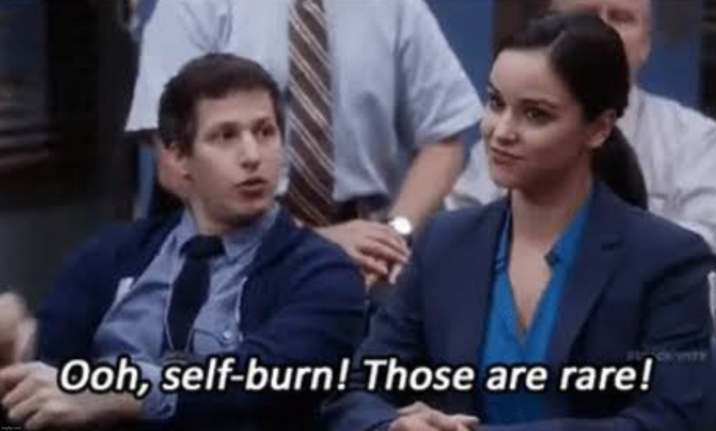
EERC Resources
Find all our Injury Training and Equipment Module Presentations on our website.
https://eaglelife.erau.edu/EERC/

