Slide 1
Eagle Emergency Readiness Club November 2022
“Always Be Ready”
KICKOFF EVENT

Slide 2
Disclaimer
“The opinions or assertions contained herein are the private views of the authors and are not to be construed as official or as reflecting the views of any professional medical provider or Embry-Riddle Aeronautical University.”
Notes:
Read the disclaimer.

Slide 3
AGENDA
EERC & PURPOSE
WHY?
THE PLAN (w/example)
TIMELINE
THE KITS (w/example)
CONSTITUTION
EQUIPMENT/TRAINING
INJURY FUNDAMENTALS (Burns/Bleeding)
ETD PRESENTATION
GEAR ISSUE

Slide 4
EERC & PURPOSE
Eagle Emergency Readiness Club
Purpose: to prepare students for a wide variety of emergency situations such as fire and medical emergencies by providing access to training, certifications, and immediate response supplies

Slide 5
WHY?
“The proportion of preventable deaths due to bleeding remains steady between close to half in civilian settings and over 80% in combat injuries”
Minor and major injuries are treatable, but not everyone has the proper training or equipment to treat them.
- Epidemiology of Hemorrhage-Related Mortality

Slide 6
THE PLAN
Types of Injury Training:
Burns
Shock
Bleeding
Poisoning
Temperature Extremes
Musculoskeletal Injuries
Bites and Stings
Medical Emergencies
Confined Spaces

Slide 7
EXAMPLE
Types of Injury Training: Burns (100) – Principles
Instruction in the principles and first aid intervention of:
assessing the severity of the burn including first degree, second degree, and third-degree burns.
differentiating between the types of third-degree burns (thermal, electrical, and chemical) and their specific interventions. Particular attention should be focused upon chemical burns, and the use of specific chemicals in the workplace which may cause them.

Slide 8
TIMELINE
KICKOFF EVENT
Burns
Bleeding
28 Nov GENERAL MEETING
Shock
Poisoning
5 Dec GENERAL MEETING
Temperature Extremes
Musculoskeletal Injuries
12 Dec SEMESTER CLOSEOUT MEETING
Bites and Stings
Medical Emergencies
Confined Spaces

Slide 9
THE KITS
Module System:
First Aid
Mini Trauma
Major Trauma
Burn
Immobilization
Mini Kits

Slide 10
EXAMPLE
Mini Kit pt.1 - Emergency Trauma Dressing
where the ETD is stored in the kit
when and why you'd use the ETD
how to use the ETD
Mini Kit pt.2 – Bandages, BZK, and Ointment
Mini Kit pt.3 – Cohesive Wrap, Pads, and Moleskin

Slide 11
CONSTITUTION
Officers
Elected or chosen; serve 2 semester terms
Meetings
Regular weekly meetings
Special events on weekends
Finances
Semesterly member dues: $20
Equipment security deposit

Slide 12
EQUIPMENT / TRAINING
Equipment
Will be issued to members who are in good standing
Kits will be refilled if the gear contained is ever used for its intended purpose
Training
In-house, injury fundamental and kit explanation presentations
First Aid, BLS, ACLS, PALS, Wilderness, …

Slide 13
Summary of Key Points
TRAINING
In-house, general injury trainings
External, official certifications
EQUIPMENT
Members must pay dues
Modules will be refilled as members require
READINESS
Our motto is: “Always Be Ready”
We are NOT a response team

Slide 14
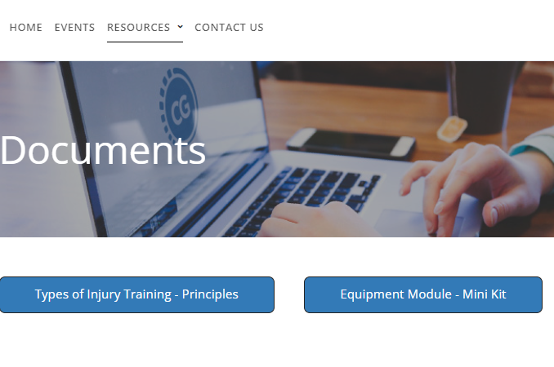
EERC Resources
Find all our Injury Training and Equipment Module Presentations on our website.
https://eaglelife.erau.edu/EERC/

